Slide 1
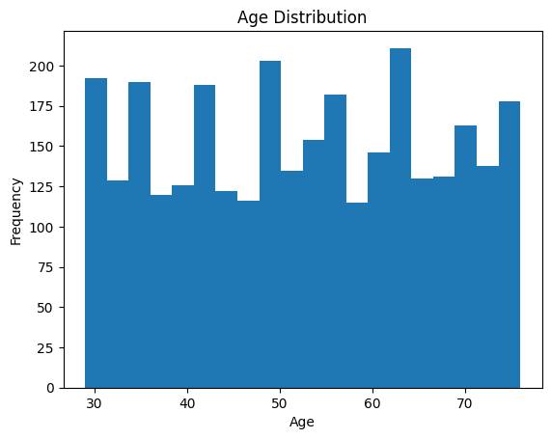
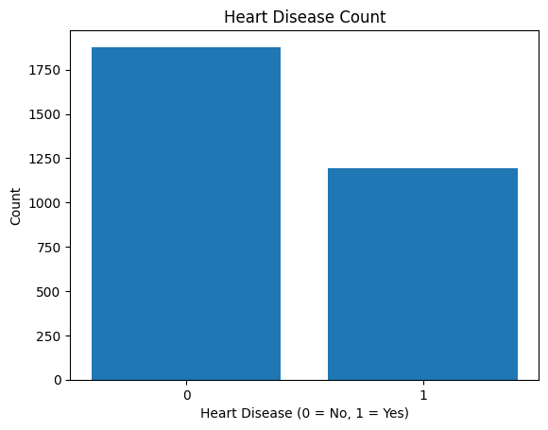
Age Distribution Shows how patient ages are distributed Most patients fall between middle-age and older age groups
Heart Disease Count Compares the number of patients with:- 0 →No heart disease 1 → Heart disease

Slide 2
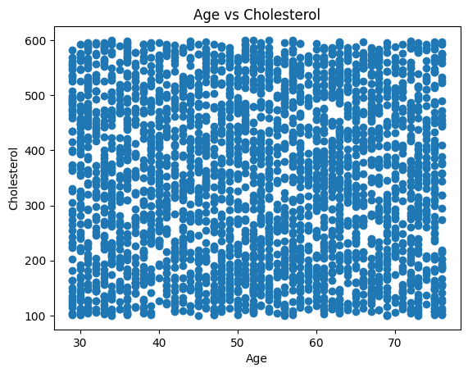
Age vs Cholesterol (Scatter Plot) Shows the relationship between age and cholesterol.Cholesterol varies widely across ages and some younger individuals also have high cholesterol Cholesterol tends to increase with age

